Slide 1

Furnish your home
Developed by:
Andrey Traykov
Stanimir Spasov

Slide 2
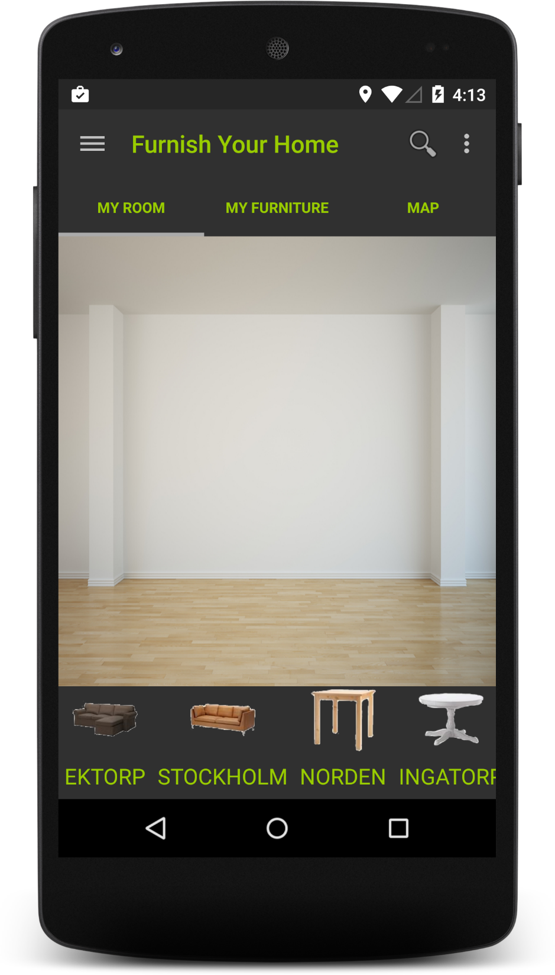
My room
Containing:
Custom Canvas View
Horizontal List View
Two Drawers

Slide 3
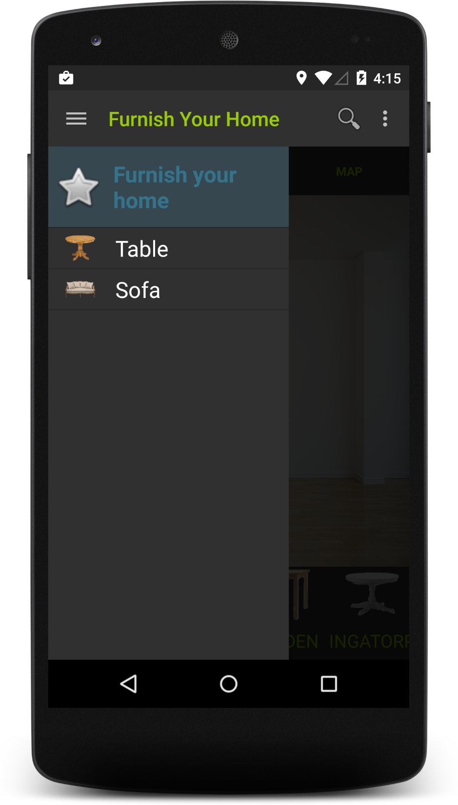
My room
You can choose from many different categories furniture.

Slide 4
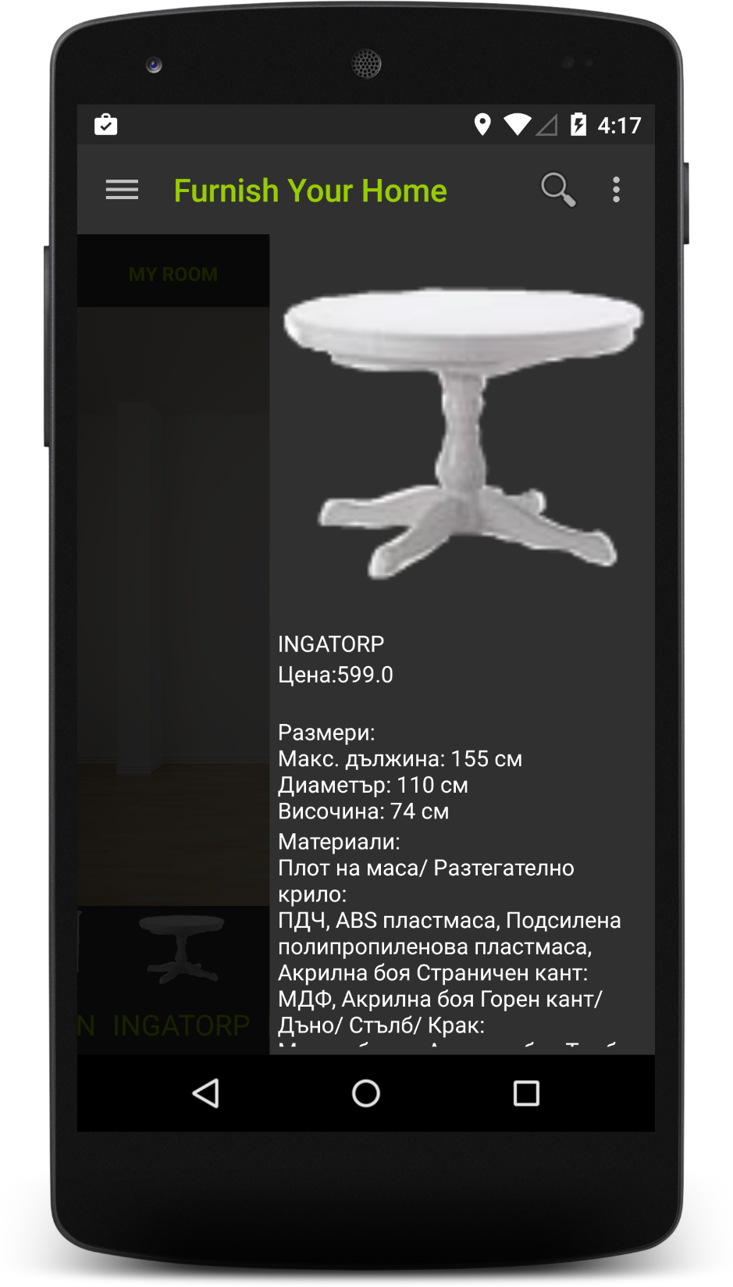
My room
There is extra info for every item.

Slide 5
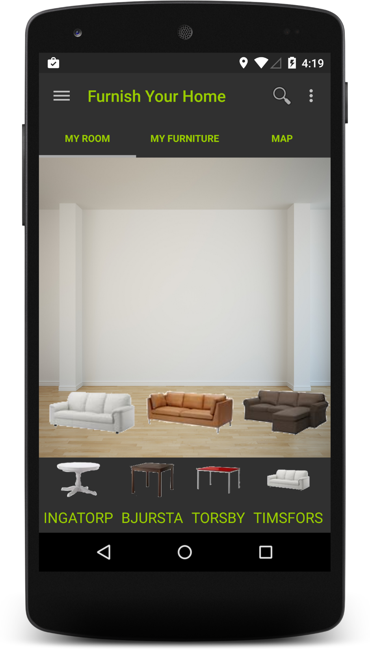
My room

Slide 6
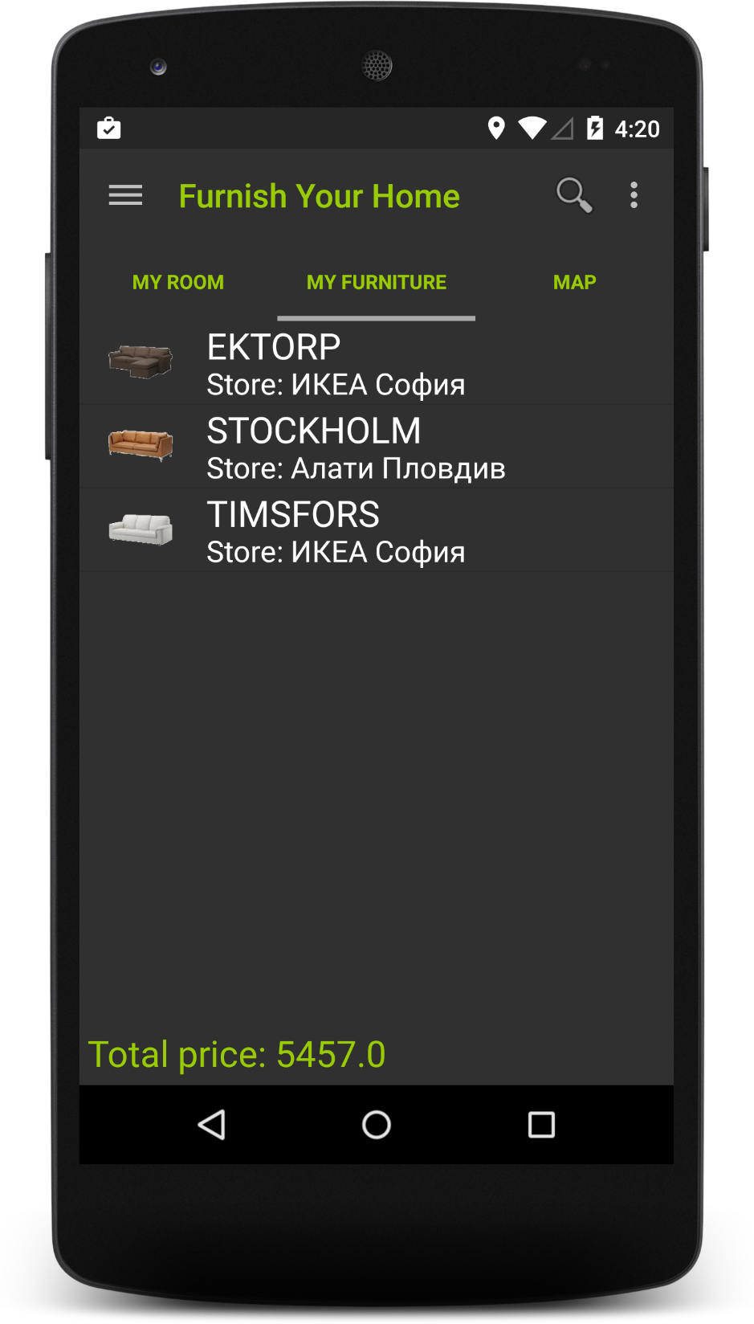
My furniture
Here you can:
Review the items in your virtual room
See which store is selling this item
Find out how much it will cost you

Slide 7
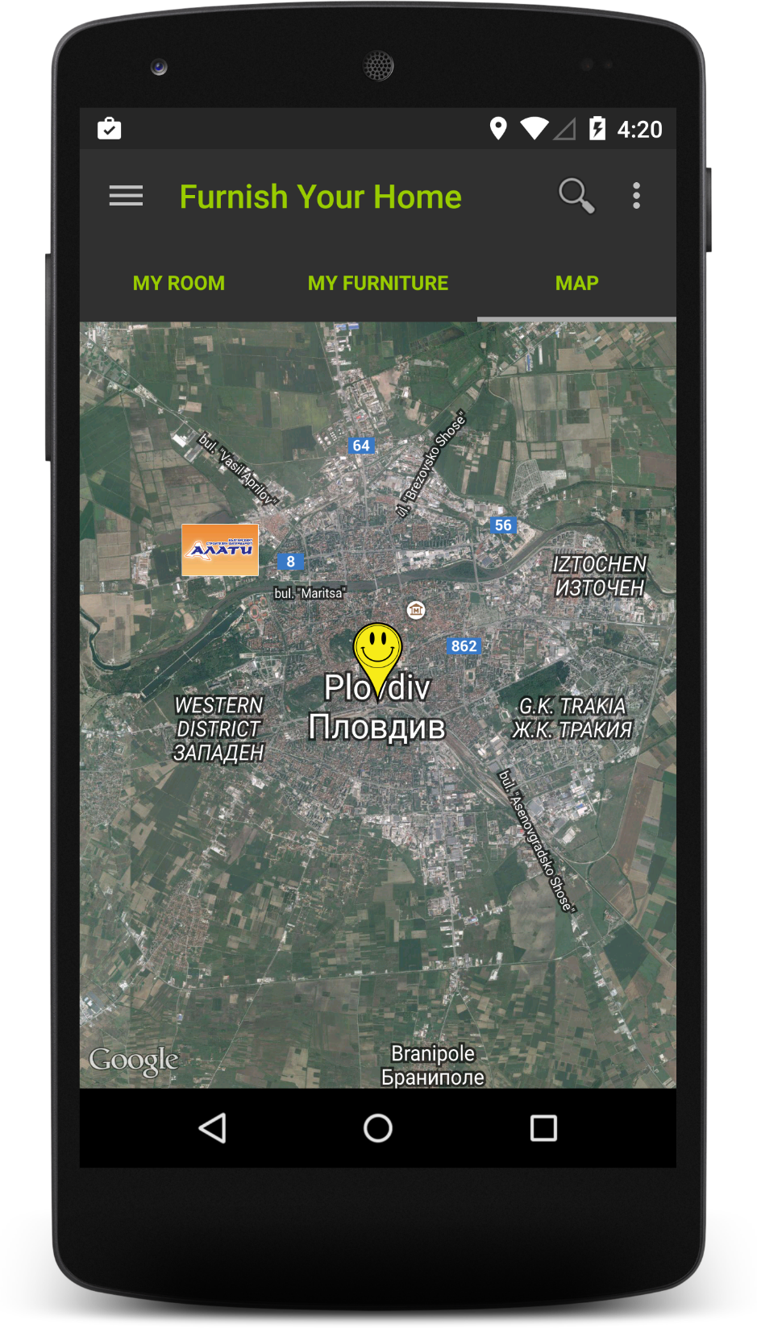
map
Simple map showing your location and the location of the stores which you can visit to buy your items.

Slide 8
Furnish your home, makes your choice easier.

